Slide 1
CLOUD COMPUTING
WITH BIG DATA
By Group 8
Group members
秦尧
林志祥
吕哲坤
刘艺奇
Group Name: SkyNet Innovator
2024

Slide 2

Project
Introduction

Slide 3
Event Booking Center
Our event publishing and booking system allows users to easily manage activities and enables seamless scheduling of events
Users can browse available slots, select their preferred time, and confirm their booking with just a few clicks.
Everything convenient

Slide 4
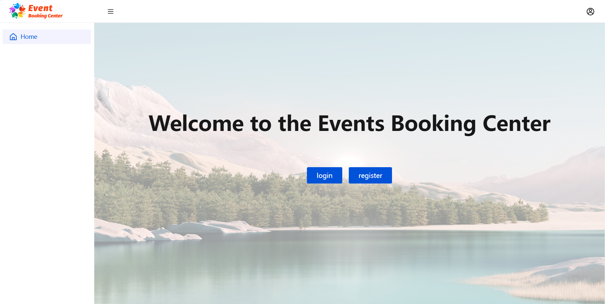
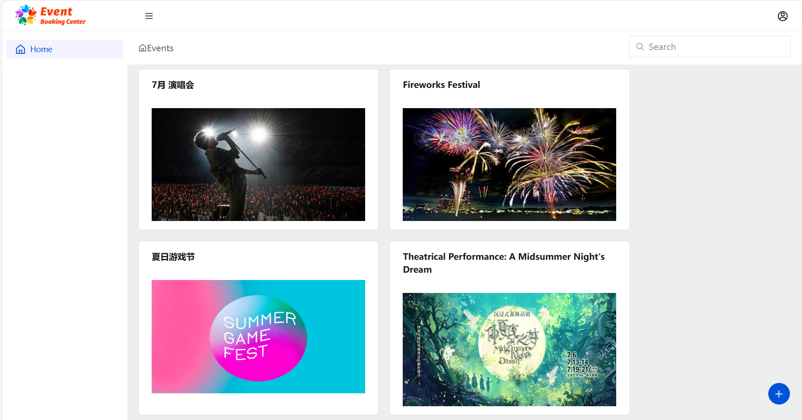
Front end display

Slide 5
Main technology stacks
Kubernetes
SpringBoot3
Slf4j
Redis
Maven
Lombok
Fastjson
MyBatis-plus
Go
HTML
Vue3
CSS
JavaScript
MySQL
JWT
Axios
RabbitMQ
Docker

Slide 6

Main technology stacks
Front-end Design
Back-end Design
Cloud Cluster
Vue3
HTML
SpringBoot3
MyBatis-plus
Kubernetes
Axios
CSS
Maven
Lombok
Docker
JavaScript
Slf4j
Fastjson
Beautiful UI design
middleware
Event booking center
RabbitMQ
Database
MySQL
Distributed database cluster
Redis

Slide 7
Microservices Architecture
There are 9 Microservice including:
User Verification
Event Operation
Data Storage
userRoutingHashGenerateService
orderRecordService
eventGlobalDataService
loginService
bookingService
registerService
eventDetailedDataService
eventPublishService
tokenVerificationService

Slide 8
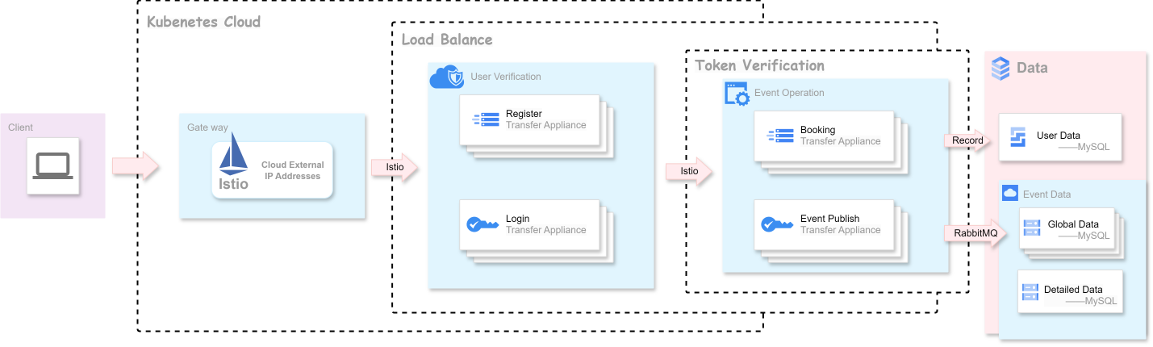
System sturucture

Slide 9
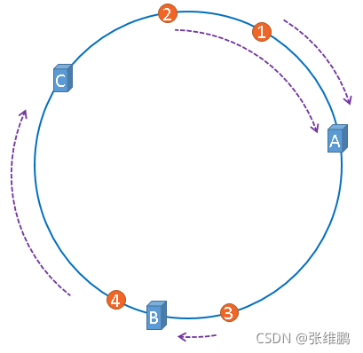

Consistent Hashing
We use consistent hashing .
Why we considered it?
For the reason : load balancing problem

Slide 10
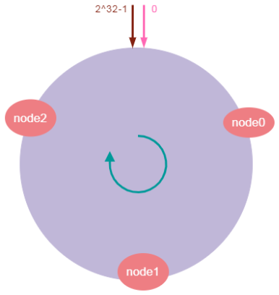
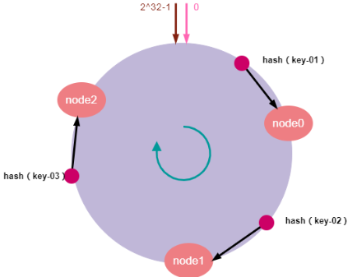
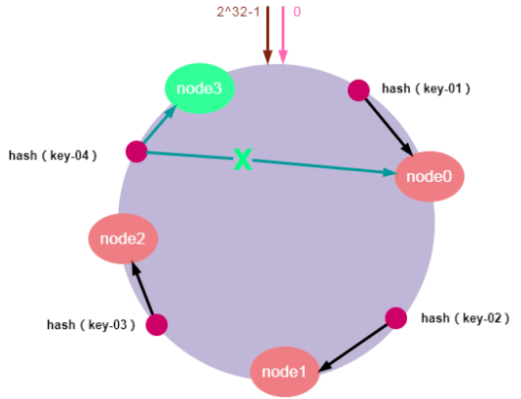
Consistent Hashing Principle
e.g. 3 Deployment.
Core Feature: Server Scaling
entire hash value space into a virtual ring
Next, 3 server deployment to the corresponding positions on the hash ring
Well-integrated with Kubernetes

Slide 11

Service mesh and Istio
Service mesh
A dedicated infrastructure layer to handle service-to-service communication in a microservices architecture
Secure, fast, and reliable
A set of lightweight network proxies
Sidecar pattern
Istio
One of the most popular service mesh implementations

Slide 12
Ingress vs. Istio
Ingress
Purpose: Focus on routing from external networks
Implementation: Requires an Ingress controller (e.g., Nginx)
Configuration: Configured through Kubernetes resource objects (Ingress)
Istio
Purpose: A comprehensive service mesh solution
Implementation: Injecting a Sidecar proxy (Envoy Proxy) into Pods
Configuration: Through a series of CRDs

Slide 13
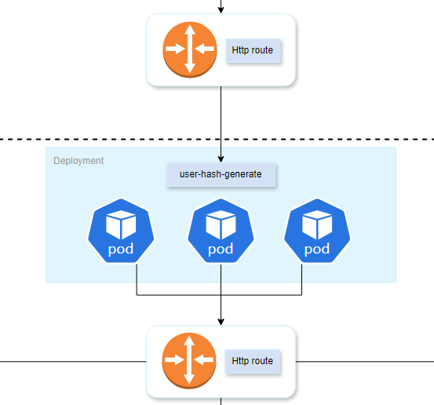
Hash generating and routing
Load balancer
Generate hash based on the email address of users
Every email address will be mapped to a hash of length 8
Routing based on hash

Slide 14
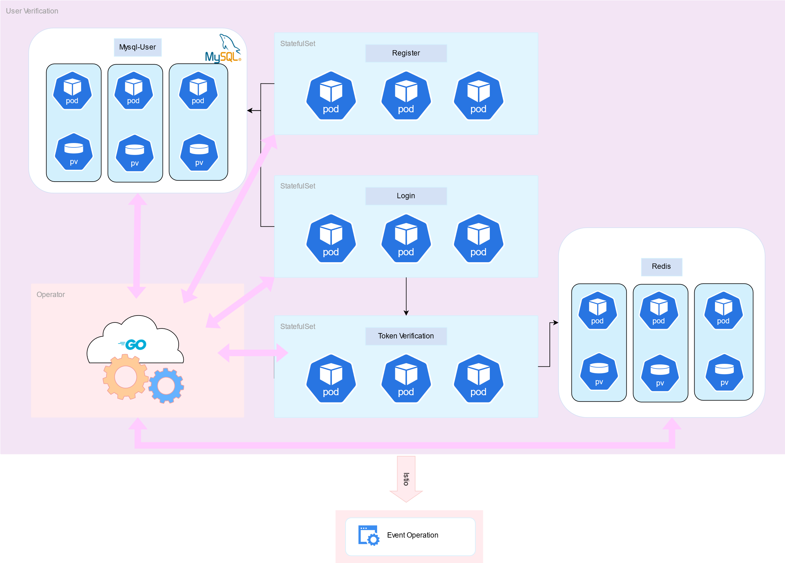
User Verification
Load balance
Cache access token for fast query speed

Slide 15
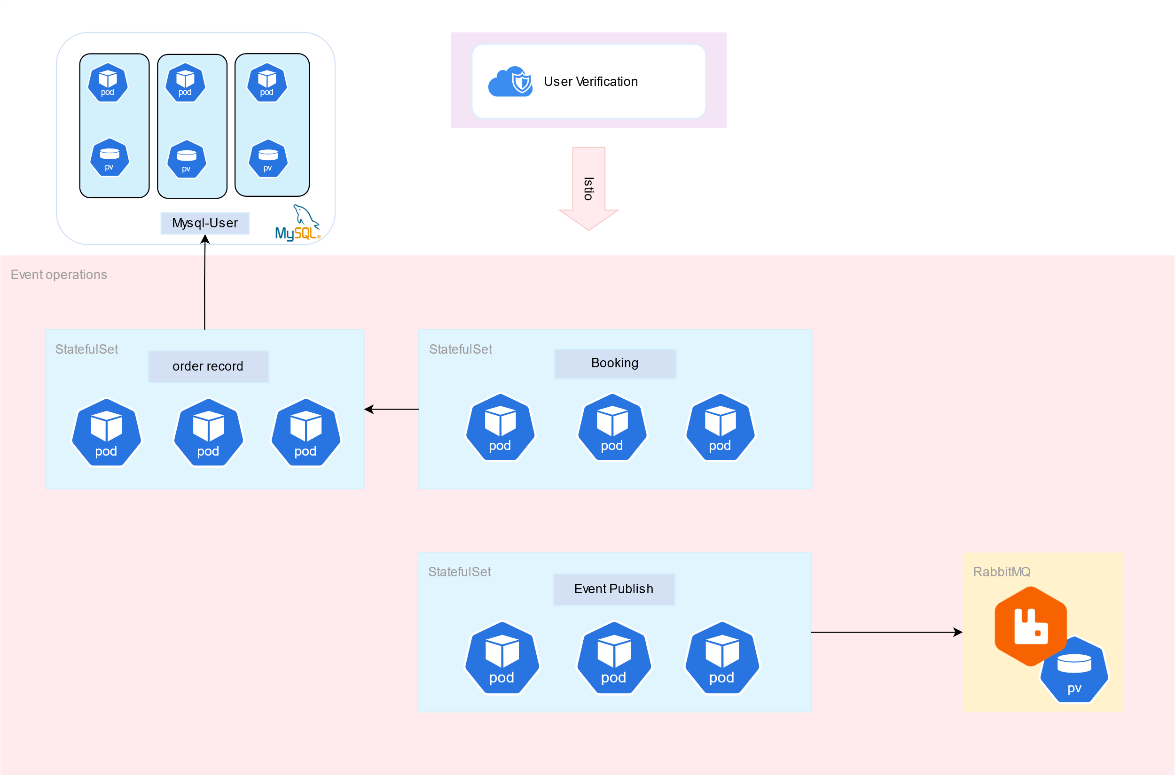
Event Operations

Slide 16
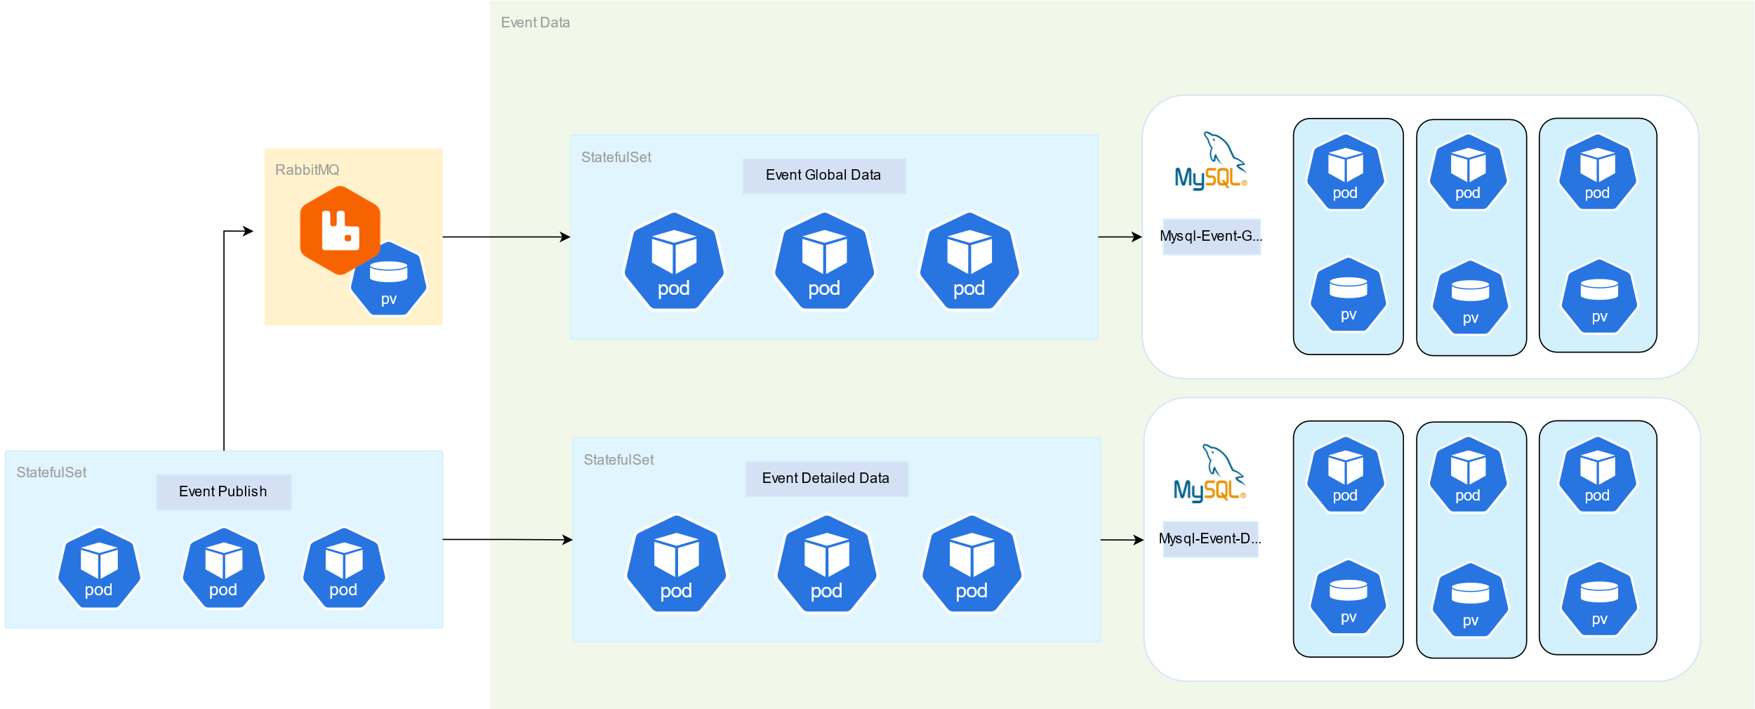
Data Storage
Act as a cache for event detailed data

Slide 17
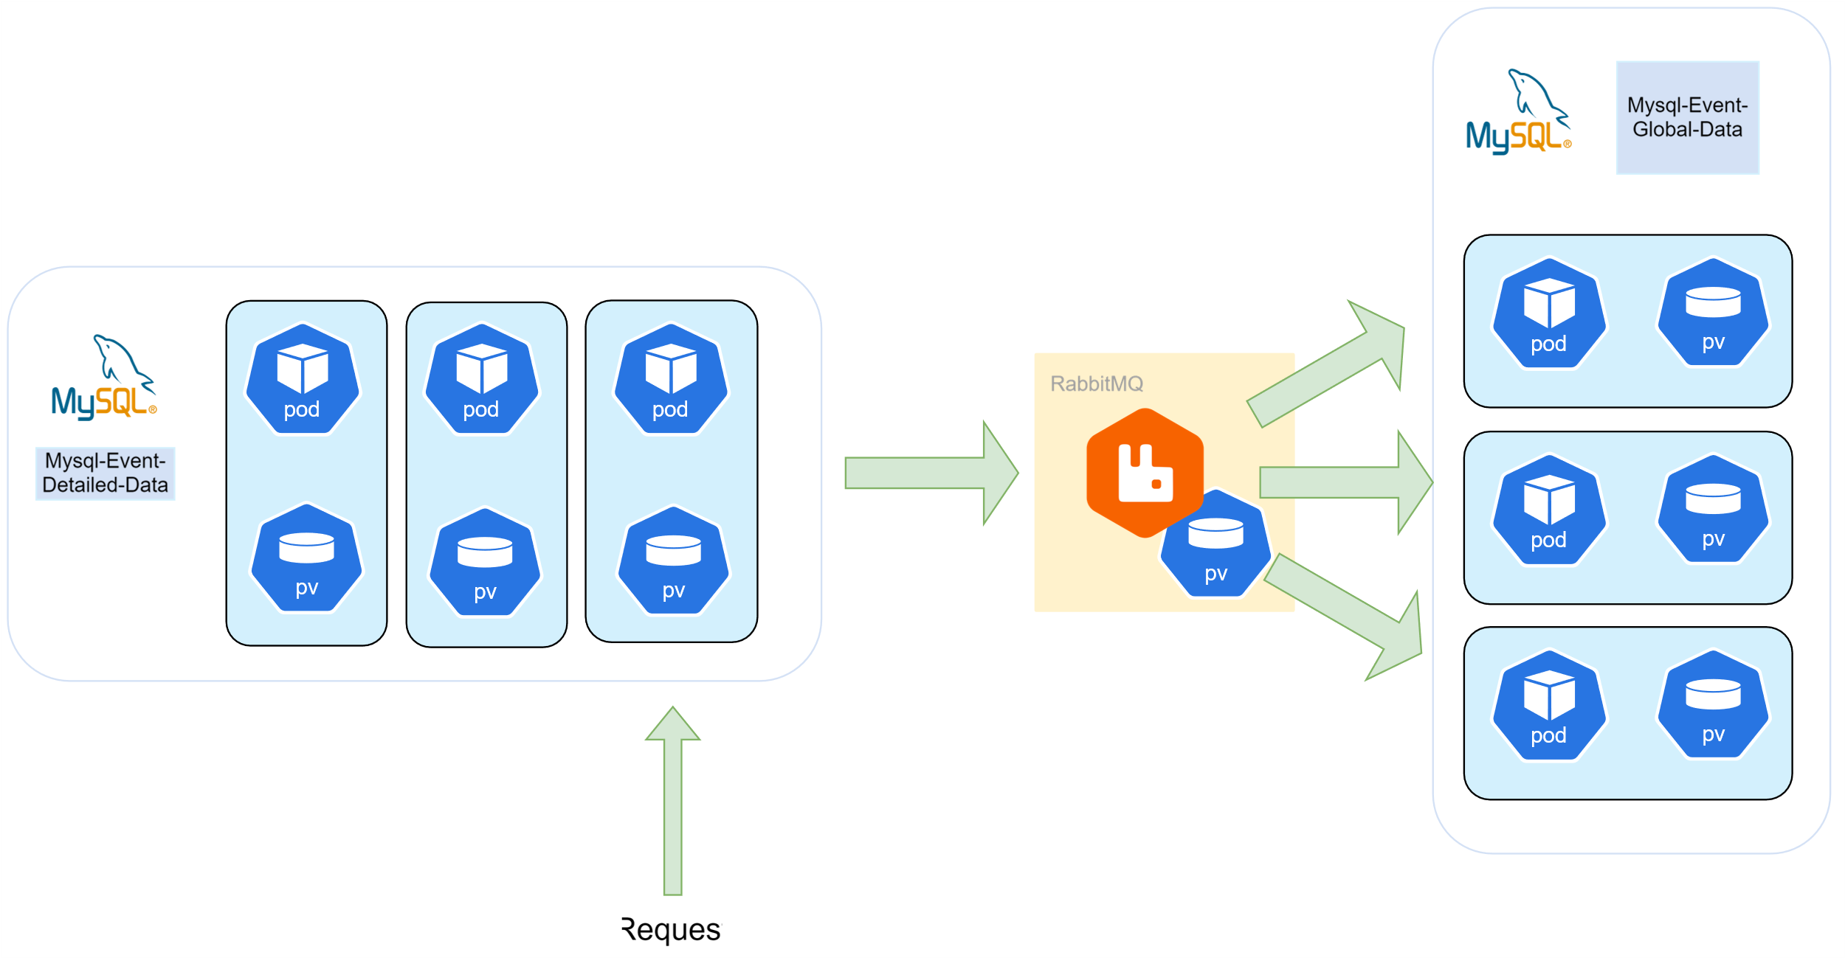
Data Synchronization

Slide 18
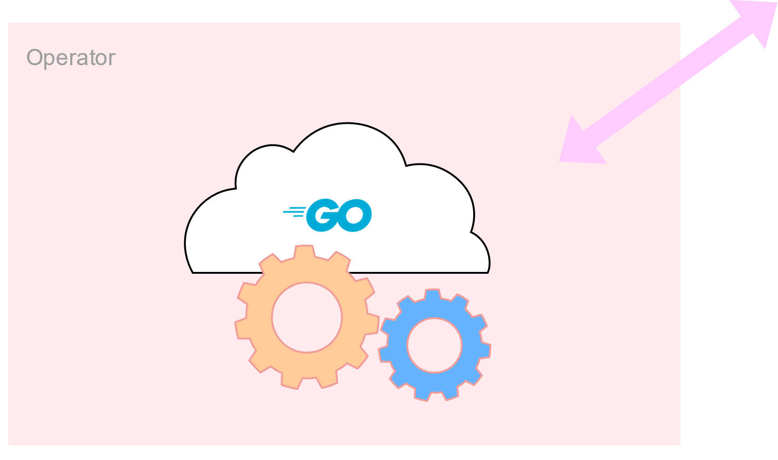
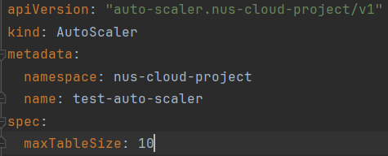
An Operator Implement by Our Own
Main purpose: Enable auto-scaling of our distributed databases
A CRD to config the operator
Watching data in databases, split it if the table size exceeds the limit

Slide 19
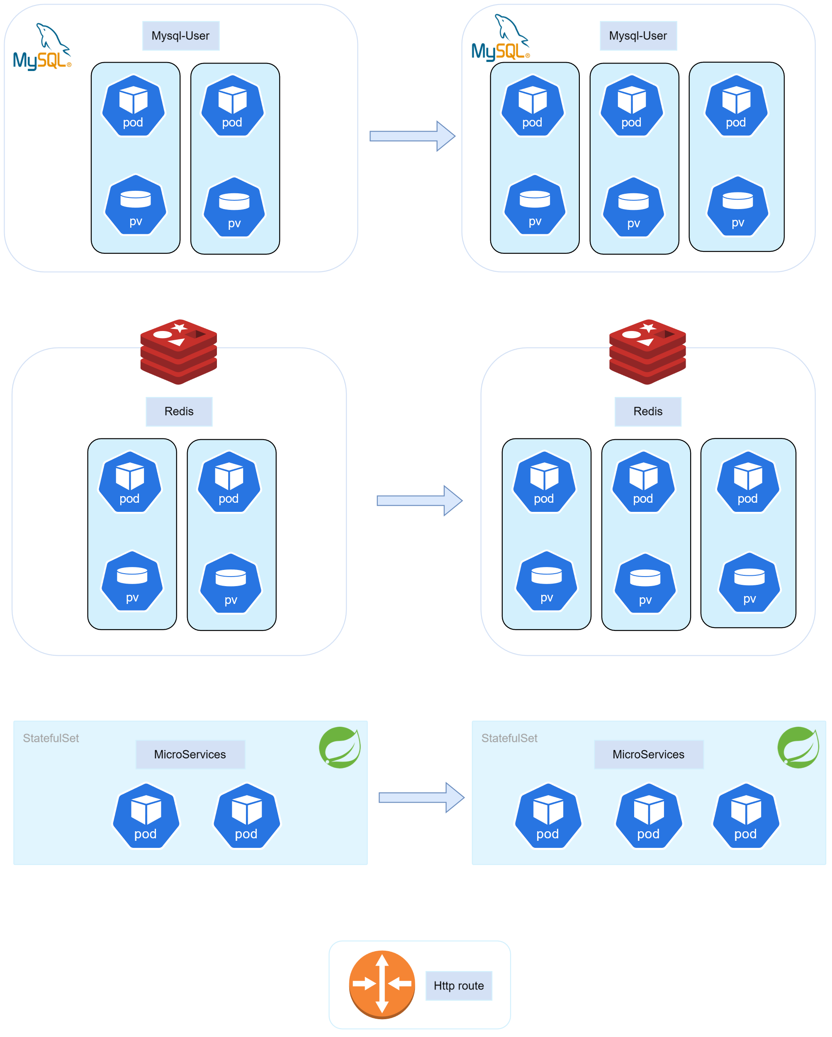
An Operator Implement by Our Own
1. Create new databases
2. Synchronize data to new databases
3. Create new microservices
4. Update routing rules

Slide 20
Our Workload
There are:
9 microservices
57 Kubernetes YAMLs
1 operator implemented by our own with about 1000 lines of Go code

Slide 21

Our Code

Slide 22

Demonstration Time

Slide 23
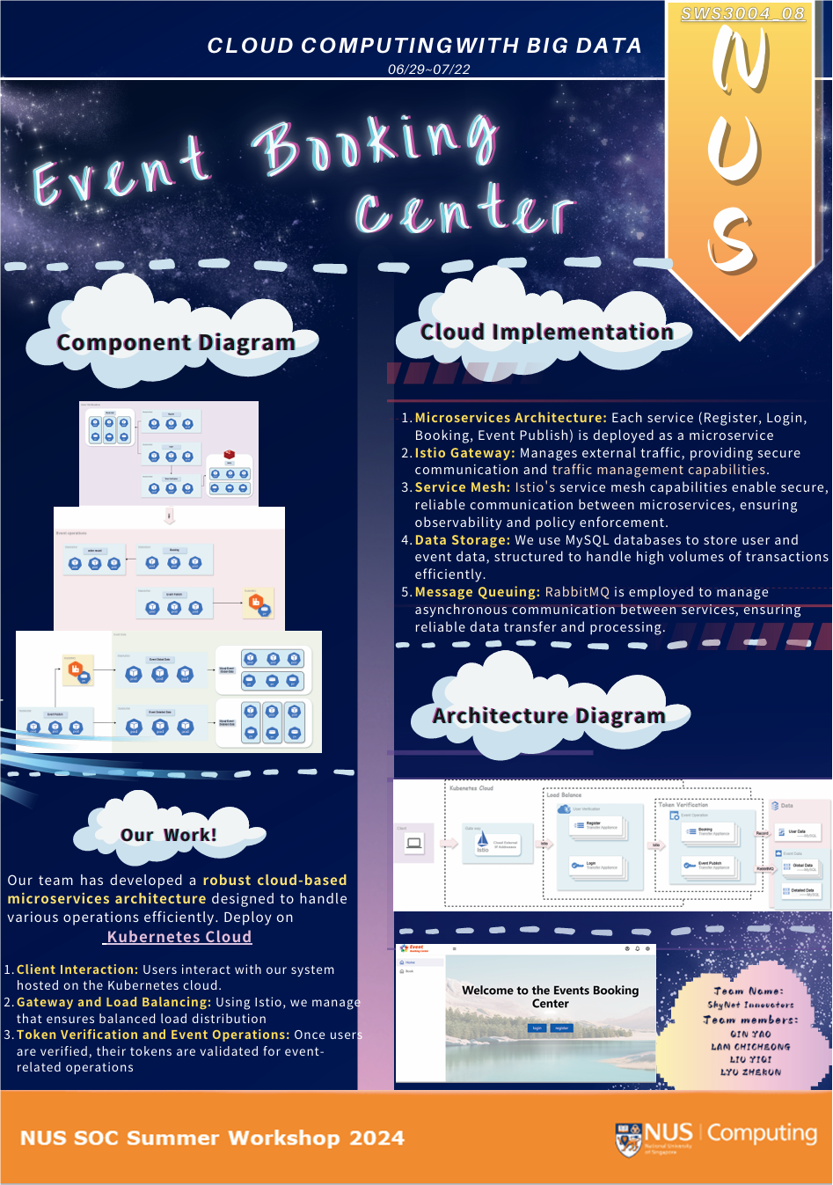
Poster

Slide 24
Project Timeline
Week1
System structure design
Learning technology
Implement backend microservices
Implement basic frontend

Slide 25
Week 2
Preliminary Work
Implement system structure on k8s
Implement routing using Istio
Implement routing by hash
Implement data synchronization using RabbitMQ
Week 3
Middle Presentation

Slide 26
Week 3
Main Development
Implement auto scaling using operator
Improve frontend
Poster and ppt
Final Presentation

Slide 27
?
?
Any Questions?
Yes
No!

Slide 28
Thanks

